Slide 1

Amazon Kindle Book Review Analysis
Course: Advanced Big Data
Professor: Yoon Sik Cho
Presenter: Hien Pham

Slide 2

Outline
01
Motivation and Problem Statement
02
Dataset
03
Proposed Solution
04
Evaluation
05
Conclusion

Slide 3

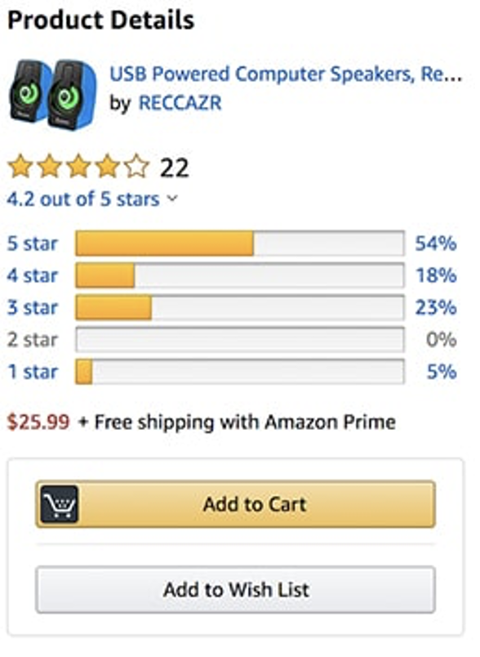
Motivation and Problem Statement
Online shopping nowadays has become a very essential part of the modern lifestyle.
People stay at home and buy goods through websites.
Amazon provides their customers with a very useful rating system, helping them evaluate the product without physical experience.
Although it works quite well, sometimes it still displays poor quality reviews on top of the forums.
This project will answer these questions:
What factors make people rate a review as helpful or unhelpful?
How to know a review is helpful or not?

Slide 4
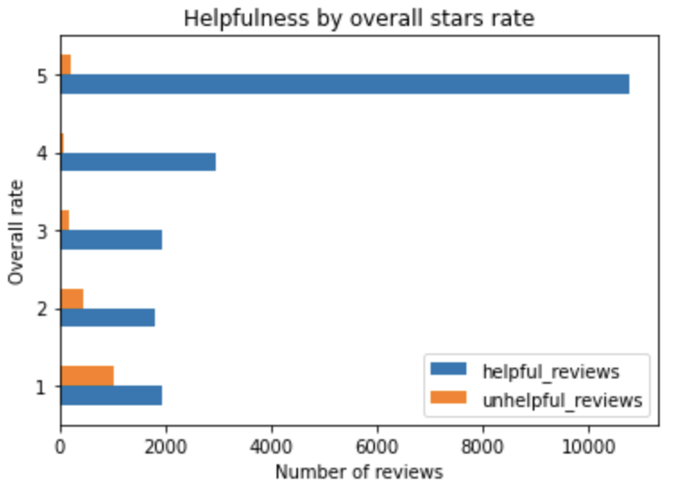
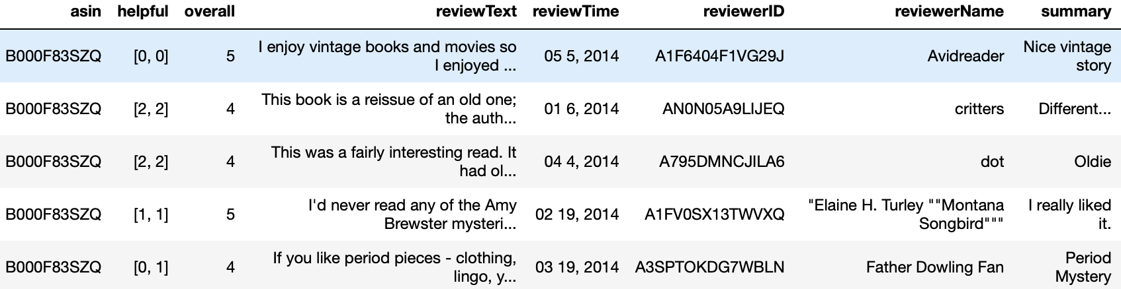
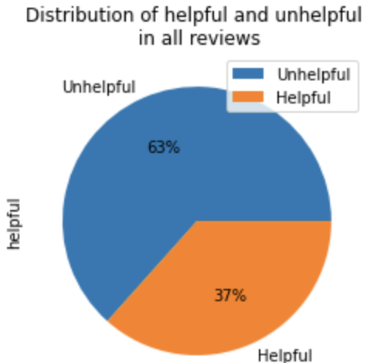
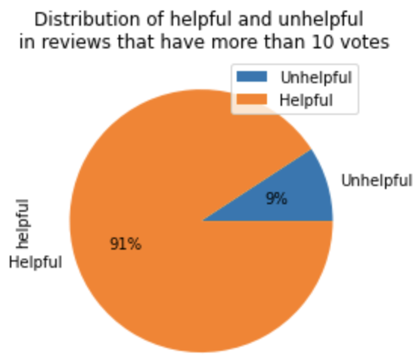
Dataset
Amazon reviews: Kindle Store Category

Slide 5
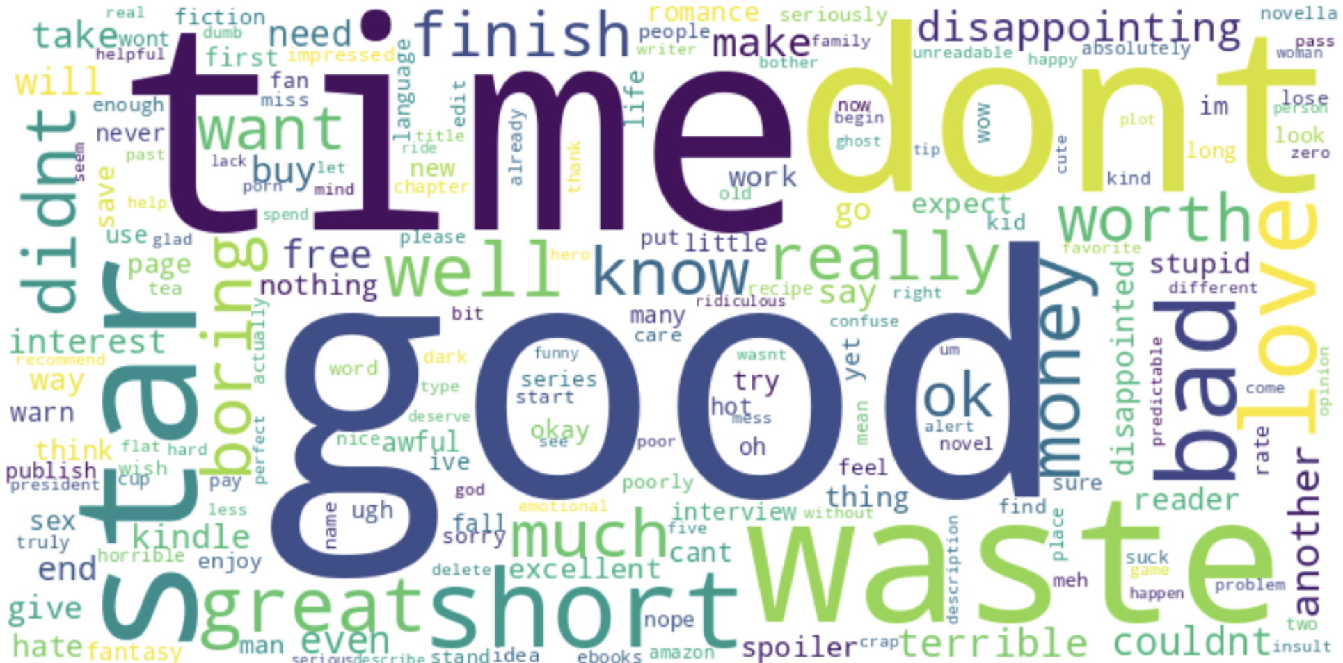
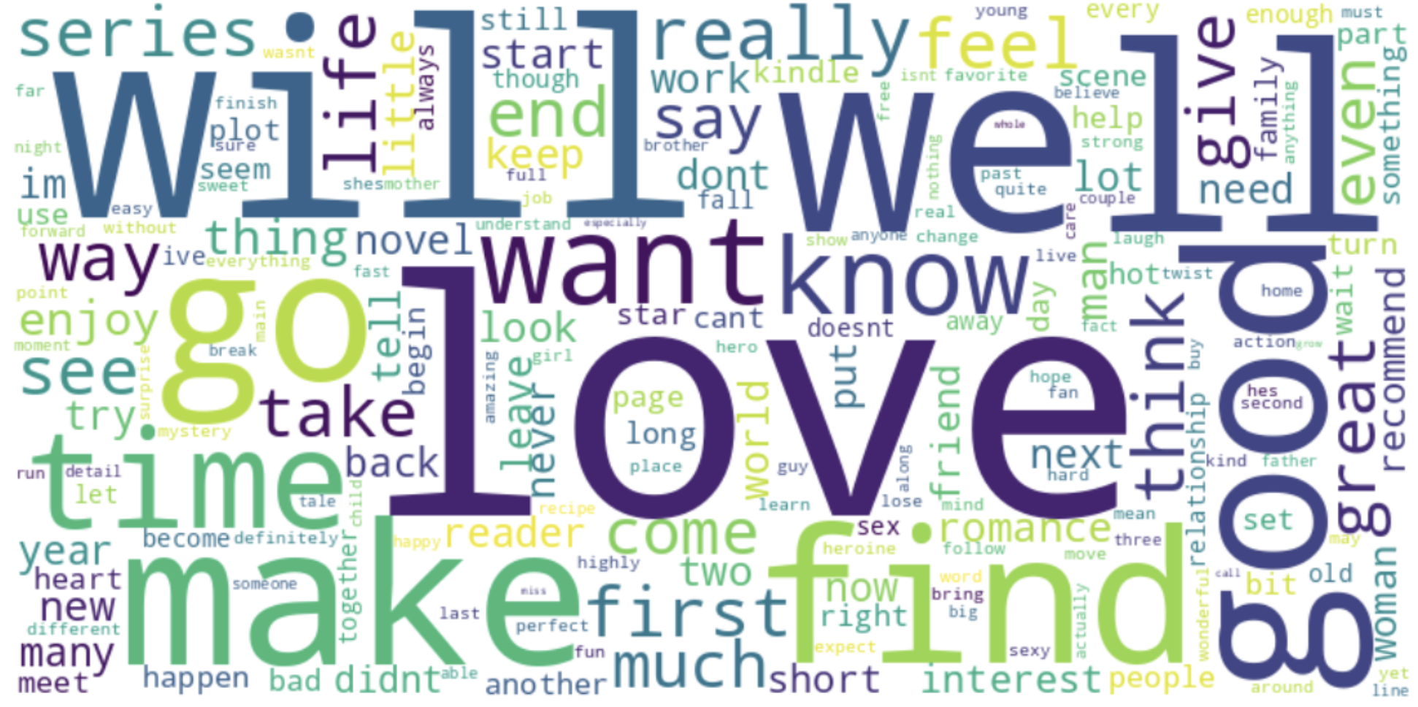
Dataset
Amazon reviews: Kindle Store Category
Reviews being rated less than 3 stars
Reviews being rated greater than or equal 3 stars

Slide 6
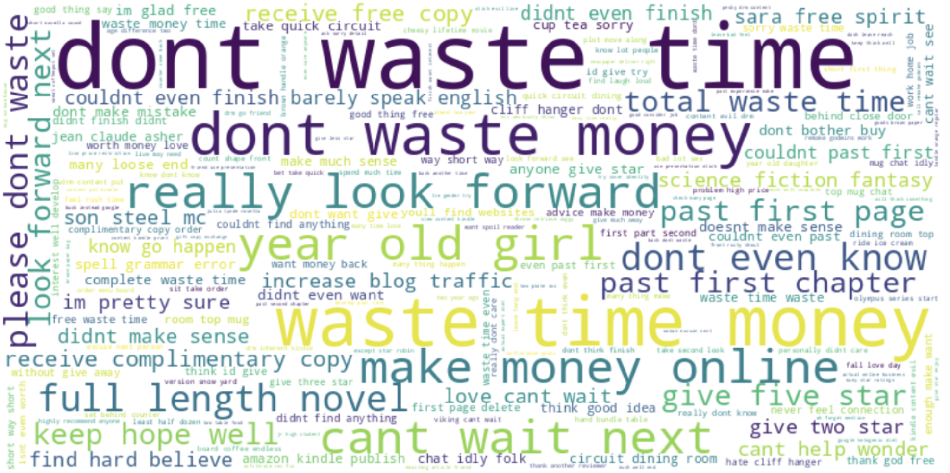
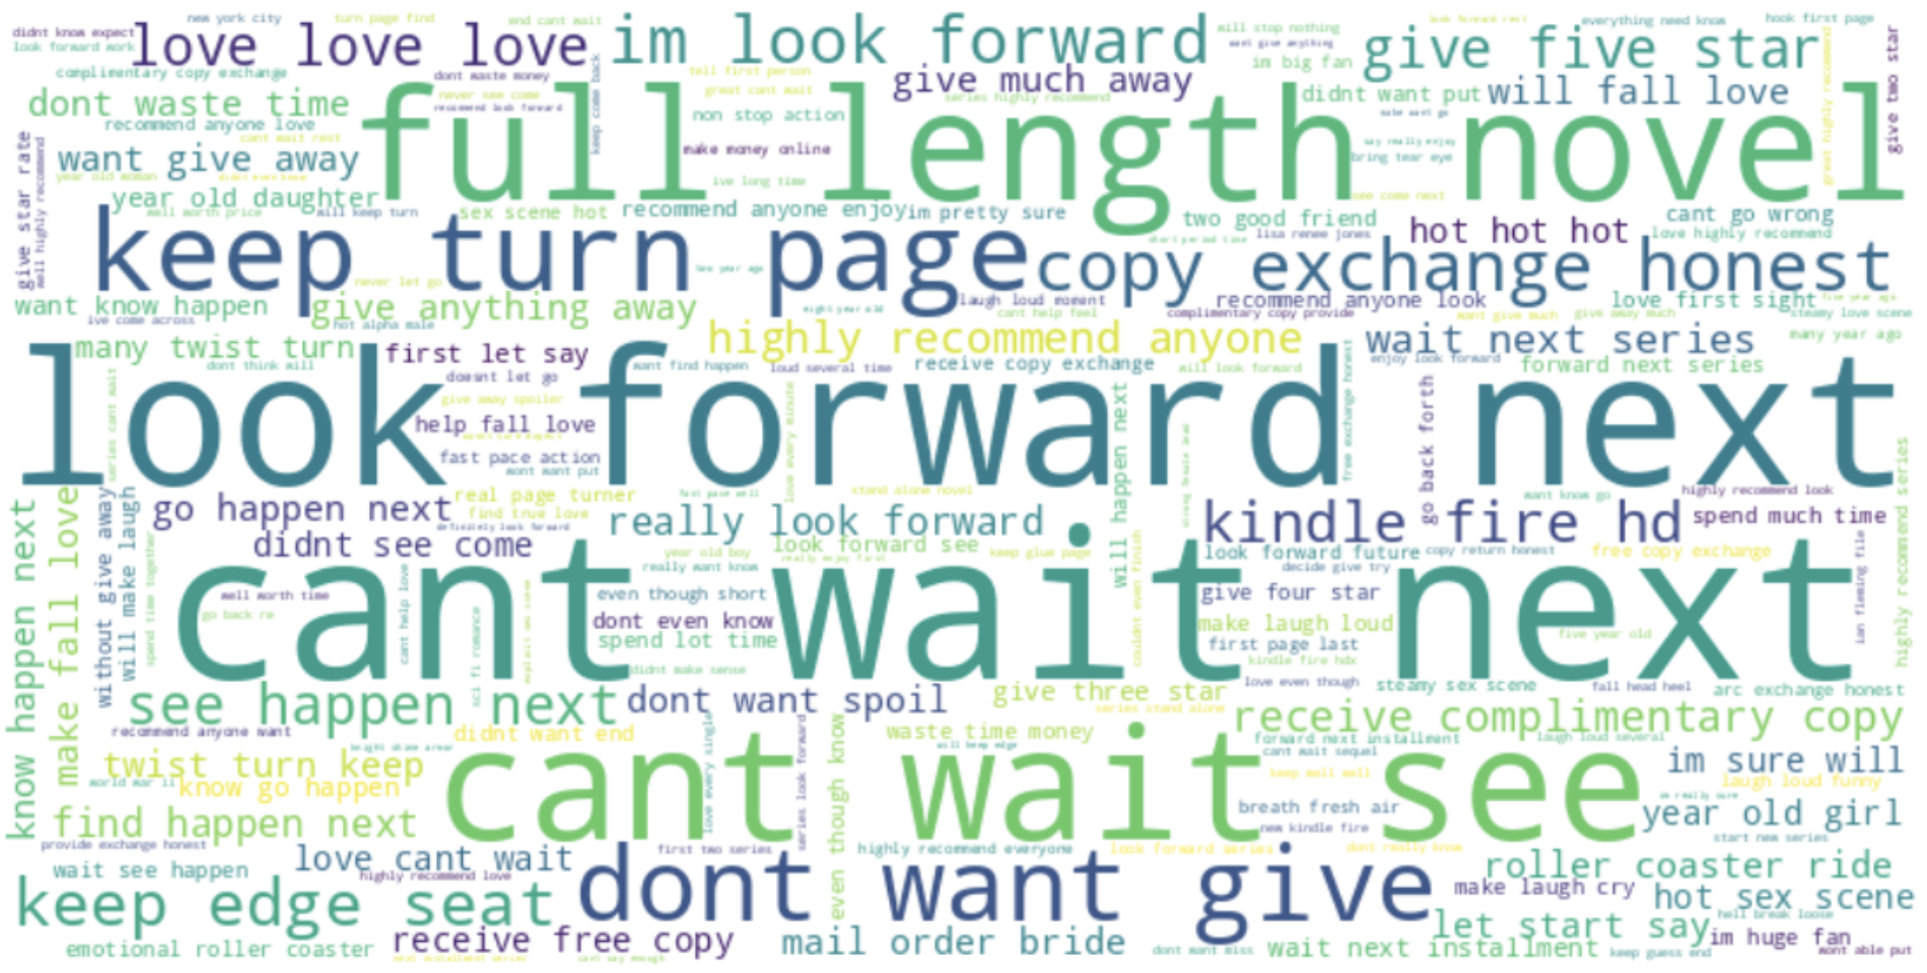
Dataset
Amazon reviews: Kindle Store Category
Word cloud of word 3-grams
Reviews being rated less than 3 stars
Reviews being rated greater than or equal 3 stars

Slide 7
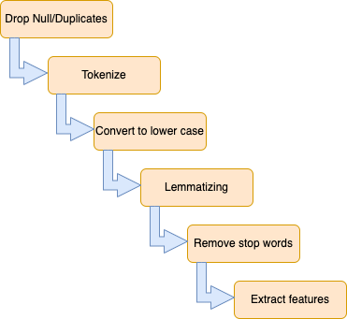
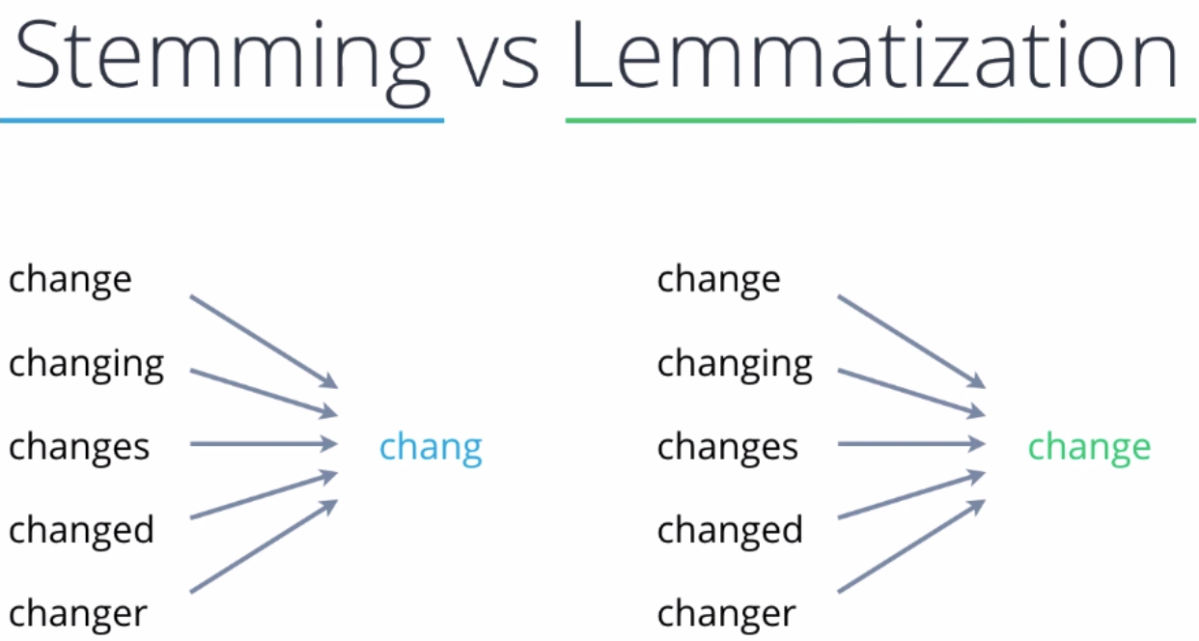
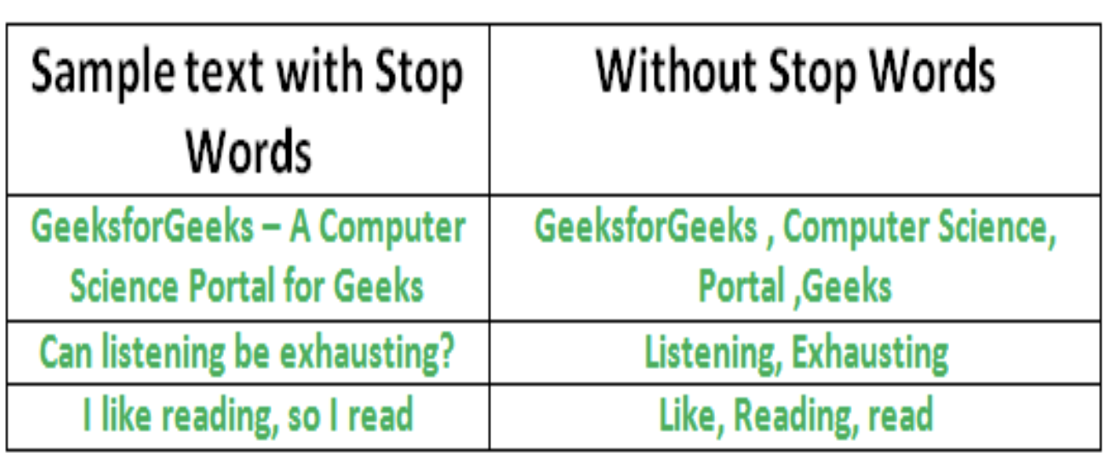
The proposed solution
1. Data Preprocessing
Step 1. Drop Null/Duplicates: Drop all the reviewText that is null/na using dropna() function. Drop all the duplicated records using distinct() function.
Step 2. Tokenize: Break the whole reviewText into individual words
Step 3. Convert to lower case
Step 4. Lemmatizing: This is to return the base or root form of a word.
Step 5. Remove stop words: Words such as I, the, a, has, etc do not carry much information and thus should be removed from the analysis.
Step 6. Extract feature

Slide 8
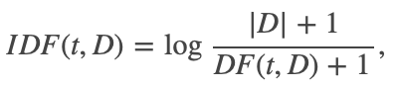
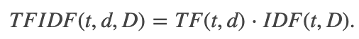
The proposed solution
1. Data Preprocessing
Step 6. Extract feature
TF-IDF (Term Frequency-Inverse Document Frequency) is applied for the reviewText column after preprocessing:
TF (Term Frequency) – In the context of term and document, TF is defined as the number of times a term appears in a document.
DF (Document Frequency) – In the context of term and all the documents in corpus, DF is defined as the number of documents that contain the term.
In Spark, we can obtain these values by:
Using HashingTF to take sets of terms and converts those sets into fixed-length feature vectors or term frequency vectors.
Using IDF to take the feature vectors and scales each feature.

Slide 9
The proposed solution
2. Models and Metric
This is a classification problem, given the star rates and the review text of one particular review, the output would return if it is heplful or not.
The dataset is very imbalanced between the two target classes. Therefore, we need to apply some technique to resolve this, two are considered:
Class weighting : Adding different class weights to the cost function of the algorithm. This prevents models from predicting the more frequent class more often just because it's more common.
Over-sampling: Duplicating examples from the minority class in the training dataset.
Data will be split as 80% for training and 20% for testing.
In this project, 4 different classification models will be implemented as baseline: Logistic Regression, Decision Tree Classifier, Random Forest Classifier, Naive Bayes.
Since our problem is of binary classification(helpful or not helpful), The Area Under the Curve (AUC) will be used as the metric to measure the ability of our model to distinguish between classes.
→ In Spark, we can obtain this by using BinaryClassificationEvaluator with metric name is "areaUnderROC"

Slide 10
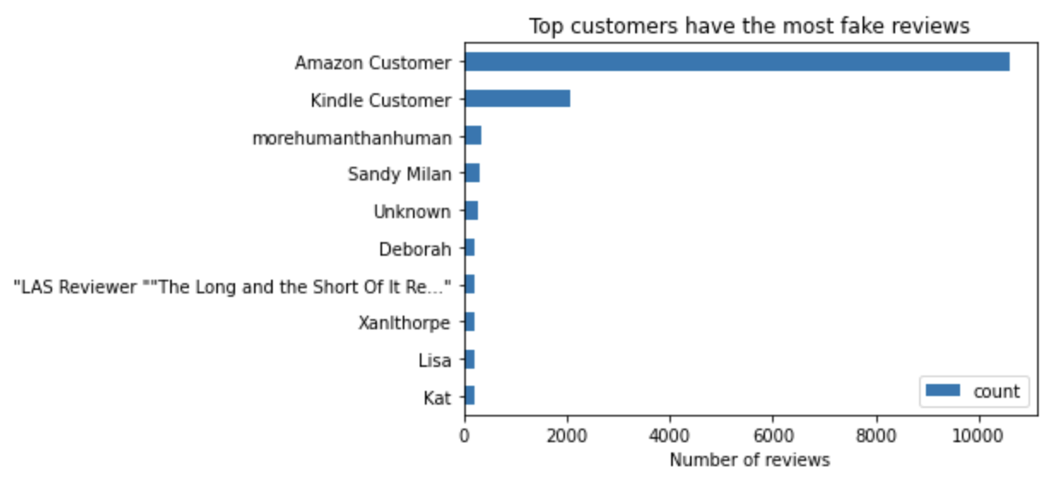
The proposed solution
3. Sentiment Analysis
Beside the main problem, another issue can be resolved by using sentiment analysis, which is finding out the fake reviews.
Let’s say the overall stars rate indicates the tone of the byers when they talk about the book. Then, Positive, Negative, and Neutral will be subjected to those rating more than 3 stars, those rating less than 3 stars, and those rating exactly 3 stars, respectively. At one time, I will use a lib call VADER (Valence Aware Dictionary and Sentiment Reasoner) to extract the tone from the review text.
Assuming that a mismatch between these two values of tone will indicate a fake review.

Slide 11
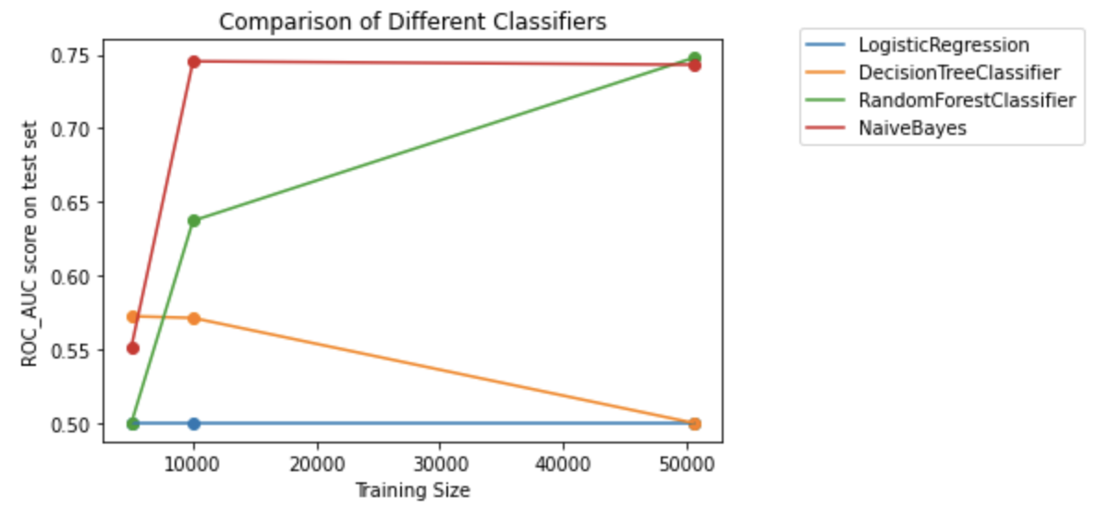
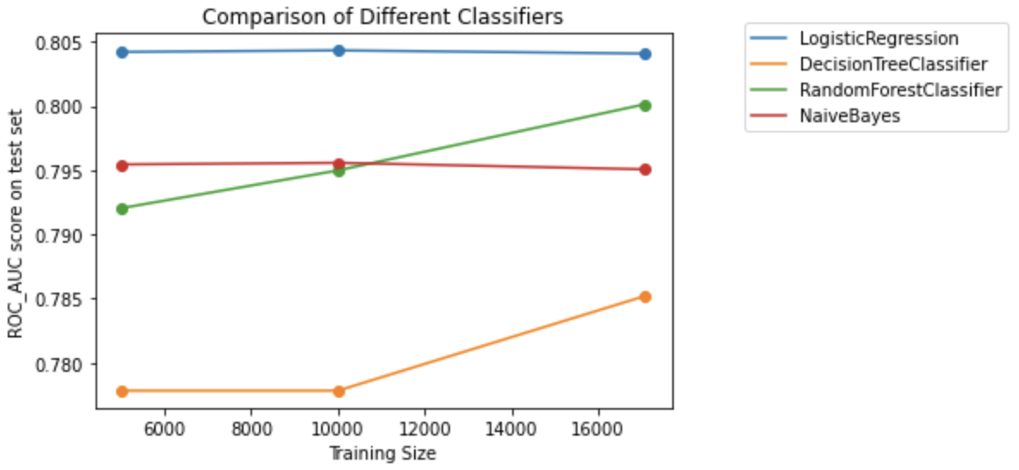
Evaluation
Comparision of model with and without class weighting
Model performance without class weighting
Model performance with class weighting

Slide 12
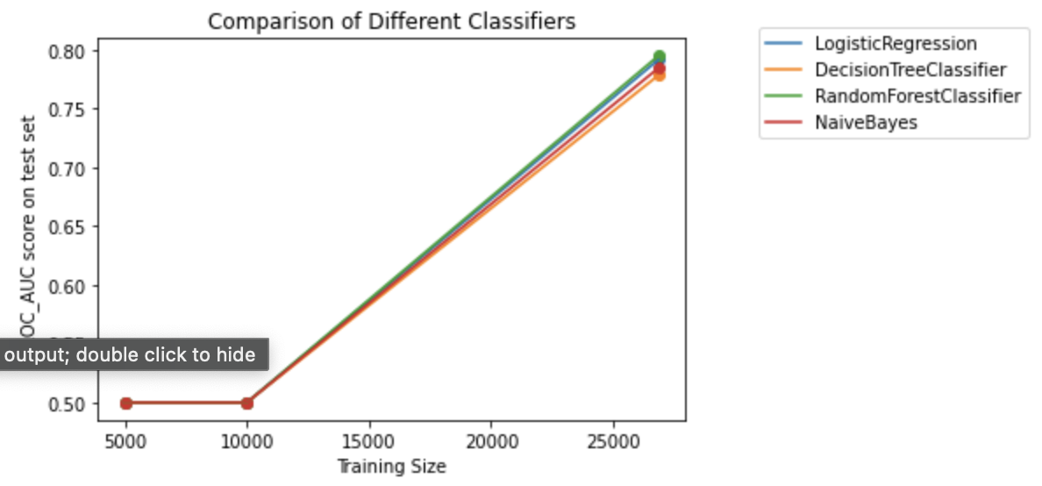
Evaluation
Comparision of class weighting and over-sampling
Model performance with class weighting
Model performance with over-sampling

Slide 13
Conclusion
In this project, I propose solution including basis of Natural Language Processing and then Machine Learning to the issue of the Amazon review system.
The solution works quite well when combining the TF-IDF vectorization with the Logistic Regression model, giving us the result of 80.04% accurate.
The issue of finding ingenuine reviews is also considered in this project. By using sentiment analysis, we can detect those customers who frequently post fake reviews.
Improving the performance of the model by adding more data or using more complex ML models can be further works.

Slide 14


